Slide 1
From Verilog To DEF
Hossam Elsamanoudy

Slide 2
Outline
Physical Design Flow:
NetList
Floor Planning
2. Project Achievements

Slide 3
Netlist
first stage in physical design flow is reading in the netlist and the constraints
It’s divided into:
Gate Level Netlist
Standard Cell Library
Technology File
Timing Constraints

Slide 4
Netlist:: Gate Level Netlist
synthesis tool is used to translate RTL into a collection of interconnected logic gates that define the logic
The most common format is verilog.
Some tools like the one done in this project internally uses some other library like Yosys to generate a json file and parse it instead of the actual verilog file

Slide 5
Netlist:: Standard Cell Library
Layout Model:
Is abstract model of the standard cell layout is used instead of the complete layout
Has PINs defined, so as to facilitate automatic routing by the tool as per your netlist.
This makes sure that the interconnection between the PINs can be routed automatically and that the routing tool will not route over existing metal/via areas thus ruling out any shorts
LEF is an ascii file, such files have the PINs and Obstructions (blockages) defined, so it can be used here.
2. Timing Model:
A a timing model is in the form of a .lib file
It could also be a .db file, which is generated from a .lib.
This liberty format file will have timing numbers for the various arcs in a cell, generally in a look up model, and may also have cell power information.

Slide 6
Netlist:: Technology File
The rules pertaining to the selected process should be given to the PnR tool (or simply to the soft floor planning tool presented here in the project). This includes metal widths, spacing, via definitions etc
Mainly in a form of a technology LEF file.

Slide 7
Netlist:: Timing Constraints
SDC files define the timing constraints of the design
It includes clock definitions, false paths, any input and output delay constraints etc.

Slide 8
FloorPlanning
the first major step in getting a layout done
determines your chip quality
define the size of your chip/block, allocates power routing resources, place the hard macros, and reserve space for standard cells
subsequent stage like placement, routing and timing closure is dependent on how good the floorplanning step is.
Includes the following iterations for best floorplanning:
Core Boundary
IO Placement/Pin Placement
Macro Placemen
Creating Power Rings and Strapst

Slide 9
FloorPlanning:: Core Boundary
Floorplan defines the size and shape of your chip/block.
top level digital design will have a rectangular/square shape, whereas a sub block may have rectangular or rectilinear shapes.
Core boundary refers to the area where standard cells and other IP blocks will be placed.
Power routing spaces may also be allocated outside the core boundary.
For a full chip, There should be IO buffers and IO pads placed outside the core boundary.

Slide 10
FloorPlanning:: Core Boundary (Cont’d)
6. floorplanning can be controlled by various parameters::
Aspect ratio: the ratio of height divided by width; determines whether you get a square or rectangular floorplan; An aspect ratio of 1 gives a square floorplan.
Core utilization: Core utilization = (standard cell area + macro cells area)/ total core area); i.e. A core utilization of 0.8 means that 80% of the area is available for placement of cells, whereas 20% is left free for routing.
Boundary: this can come in handy when there exists a boundary from a previous version. When Boundary is the control parameter, both aspect ratio and core utilization are irrelevant.

Slide 11
FloorPlanning:: IO Placement/Pin Placement
We need to place IO pads and IO buffers of the chip
Take a reactangular or square chip that has pads in four sides.
the sides and relative positions of the PADs may be given by the designers.
will also get a maximum and minimum die size according to the selected package
Doing a digital block, requires you to place pins around the boundary to connect to the higher level routing.
a DEF file or a custom floorplan file is used to do this.

Slide 12
FloorPlanning:: Macro Placement
After having the size & shape of the floorplan ready and initialized the floorplan, thereby creating standard cell rows, it’s time to place the macros
Flylines in the design tool can show the connection between the macros and standard cells or IOs:
Use flylines and make sure to place blocks that connects to each other closer
For a full-chip, if hard macros connect to IOs, place them near the respective IOs
Consider the power straps while placing macros. It is possible to club macros/memories

Slide 13
FloorPlanning:: Creating Power Rings &Power Straps
decide on the trunks that supply power to the core.
make sure that all the hard macros have sufficient rings/straps around it to hook into the PG trunks
a robust power structure will take iterations and IR drop analysis at a later stage, but a close approximation can be arrived at the initial stages.

Slide 14
Project Achievements
It outputs the def file format with the following sections included:
Header
Rows
Tracks
Vias
Components
Pins
Nets

Slide 15
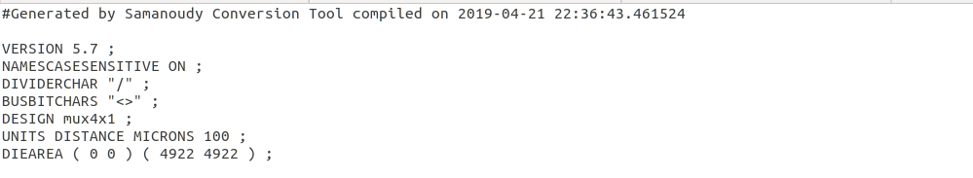
Project Achievements:: Header

Slide 16
Project Achievements:: Rows

Slide 17

Project Achievements:: Tracks

Slide 18
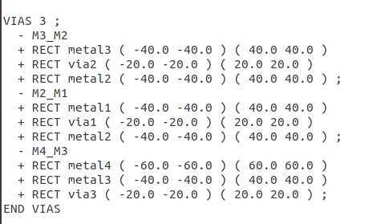
Project Achievements:: Vias

Slide 19
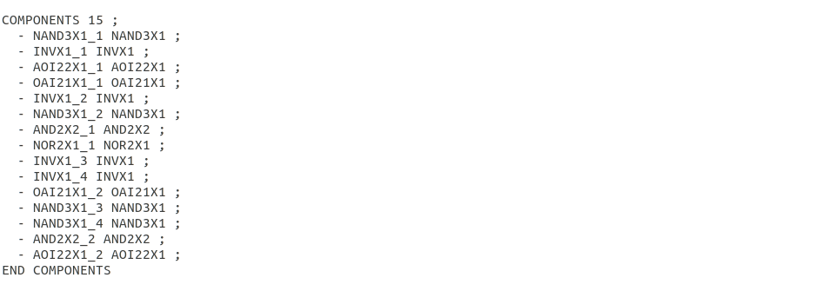
Project Achievements:: Components

Slide 20
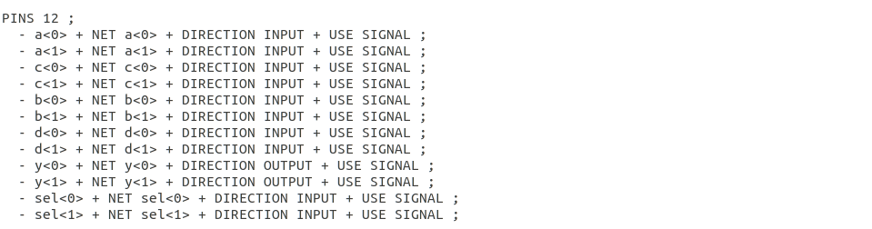
Project Achievements:: Pins

Slide 21
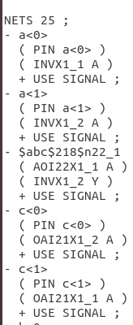
Project Achievements:: Nets

